Slide 1
Bryan Prescott, PharmD, MBA
Director of Management Coaching Services at PCCA
Cindy Moon, MPH, MPP
Vice President of Health Care Payment and Delivery Reform at Hart Health Strategies

Slide 2
What are we going to discuss?

Slide 3
COVID-19 Timeline
https://www.businessinsider.com/coronavirus-pandemic-timeline-history-major-events-2020-3

Slide 5
Who is ELIGIBLE?
Entities that have suffered substantial economic injury caused by a disaster provided they were in existence on January 31, 2020:
Businesses with fewer than 500 employees
Sole proprietors
Independent contractors
Most private nonprofits
https://www.uschamber.com/sites/default/files/uscc_covid19_sb-economic-injury-disaster-loans.pdf

Slide 6
What are the LOAN PARAMETERS?
The maximum EIDL is a $2 million working capital loan
Rate of 3.75% for businesses and 2.75% for nonprofits
Borrowers do not have to prove they could not get credit elsewhere
Up to a 30-year term
Payments are deferred for one year
Approval can be based on a credit score
No collateral is required for loans of $25,000 or less
For loans of more than $25,000, general security interest in business assets will be used for collateral instead of real estate
Up to $200,000 can be approved without a personal guarantee
Must apply by December 16, 2020
https://www.uschamber.com/sites/default/files/uscc_covid19_sb-economic-injury-disaster-loans.pdf

Slide 8
How can I access an
EMERGENCY $10,000 GRANT?
Eligible applicants for an EIDL can receive a $10,000 emergency grant within three days of application
There is no obligation to repay the grant
To receive the $10,000 emergency grant, it is not necessary to have an approved EIDL loan

Slide 9
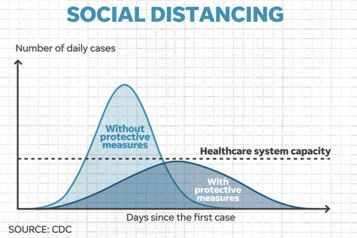

Slide 10
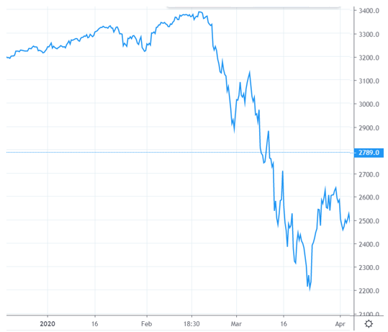
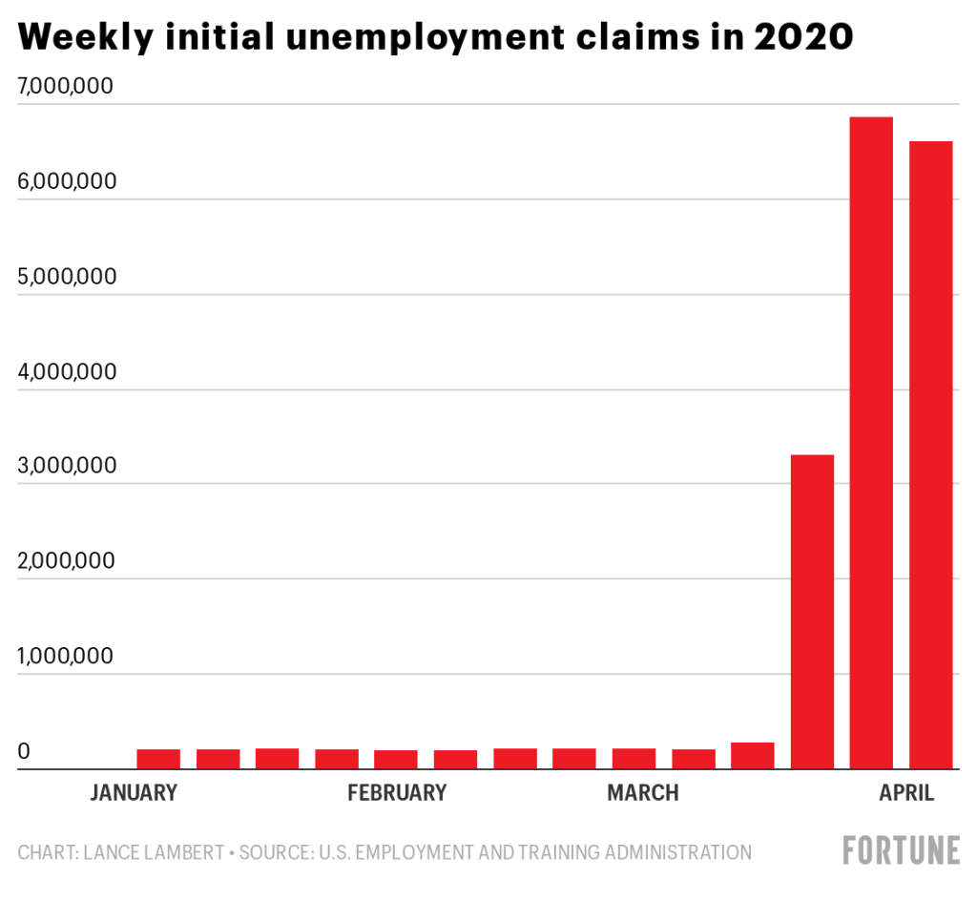
Market and Unemployment

Slide 12
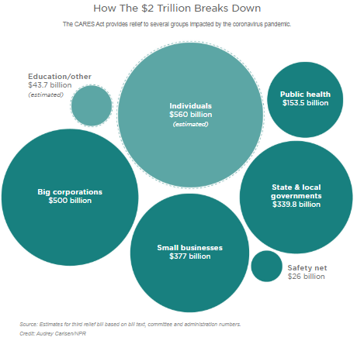
10 WEEKS
OF PAYROLL!

Slide 13
Who is ELIGIBLE?
Businesses with fewer than 500 employees
Sole proprietors
Independent contractors
An individual who is self-employed who regularly carries on any trade or business
https://www.uschamber.com/sites/default/files/023595_comm_corona_virus_smallbiz_loan_final.pdf

Slide 14
How much can I BORROW?
2.5 x the borrower’s average monthly payroll up to $10 million maximum
https://www.uschamber.com/sites/default/files/023595_comm_corona_virus_smallbiz_loan_final.pdf

Slide 15
What’s included in PAYROLL COSTS?
Salary, wage, commission, or similar compensation
Payment of cash tip or equivalent
Payment for vacation, parental, family, medical, or sick leave
Allowance for dismissal or separation
Payment for group health care and retirement benefits
Payment of state or local tax assessed on the compensation of the employee
https://www.uschamber.com/sites/default/files/023595_comm_corona_virus_smallbiz_loan_final.pdf

Slide 16
Actual Annualized Salary
$120K
$35K
What’s NOT included in PAYROLL COSTS?
Compensation of an individual employee in excess of an annual salary of $100,000
Contributions to healthcare and retirement benefits are not part of amount deemed in excess of $100,000 annual salary
PPP Adjusted Salary
$100K
$35K
https://www.uschamber.com/sites/default/files/023595_comm_corona_virus_smallbiz_loan_final.pdf

Slide 17
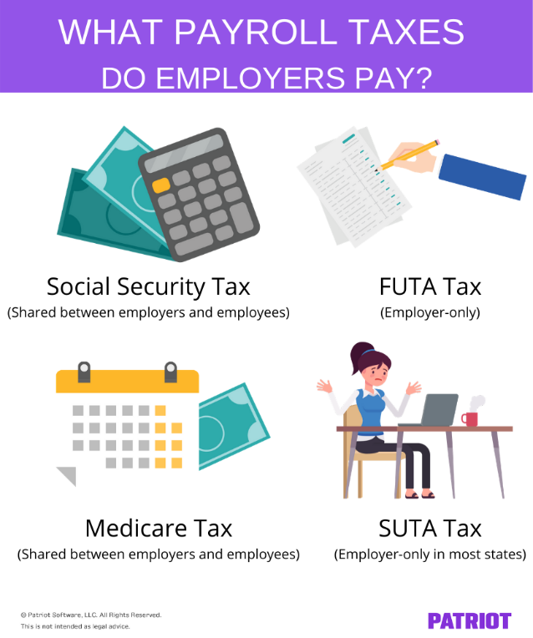
What’s NOT included in PAYROLL COSTS?
Employer portion of payroll taxes
Any compensation of an employee whose principal place of residence is outside of the United States
Qualified sick leave wages of family leave wages for which a credit is allowed under the Families First Coronavirus Response Act (FFCRA)
https://www.uschamber.com/sites/default/files/023595_comm_corona_virus_smallbiz_loan_final.pdf

Slide 18
What are the LOAN TERMS?
“Program is open until June 30, 2020”
Payments deferred for six months
1.00% fixed interest rate
Loan is due in two years
https://www.uschamber.com/sites/default/files/023595_comm_corona_virus_smallbiz_loan_final.pdf

Slide 19
Will the loan be FORGIVEN?
A borrower is eligible for loan forgiveness equal to the amount the borrower spent during the 8-week period beginning on the date of the origination of the loan on the following items:
Payroll Costs
Rent and utilities
Interest on mortgage (but not principle) incurred in the ordinary course of business
Interest on other debt obligations (but not principle) incurred before Feb 15, 2020
https://www.uschamber.com/sites/default/files/023595_comm_corona_virus_smallbiz_loan_final.pdf

Slide 20
Will the loan be FORGIVEN?
The amount of loan forgiveness is reduced if there is a reduction in the number of employees or a reduction of greater than 25% in wages paid to employees making less than $100K annualized
Reductions in employment or wages that occur between February 15, 2020 and April 26, 2020 shall not reduce the amount of loan forgiveness IF by June 30, 2020 the borrower eliminates the reduction in employees or reduction in wages
75% of the PPP funds must be directed toward payroll
25% can be directed to rent, utilities, and certain interest on loans
https://www.uschamber.com/sites/default/files/023595_comm_corona_virus_smallbiz_loan_final.pdf

Slide 21
Primary Business Checking Account
$100K
Secondary PPP Checking Account
$100K

Slide 22
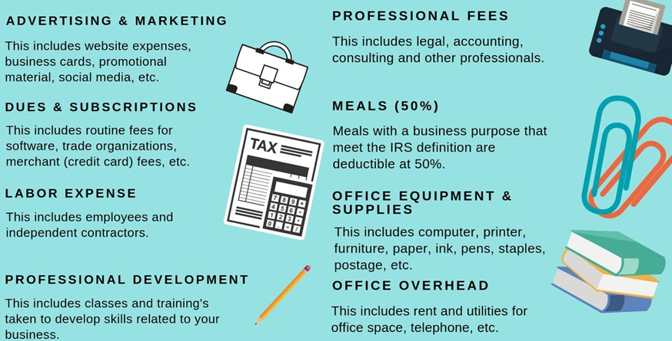
The Paycheck Protection Program (PPP) prohibits borrowers from taking out two loans for the same purpose.
#1
Working Capital Loan

Slide 23
Forgivable
Portion

Slide 25
2 WEEKS
2/3rd
NORMAL PAY
2 WEEKS NORMAL FULL PAY

Slide 26
10 ADDITIONAL WEEKS
2/3rd
NORMAL PAY

Slide 27
Effective April 1, 2020 through December 31, 2020
The Department of Labor (DOL) deemed pharmacies “health care providers” and as such, MAY BE EXCLUDED from both the 2 week paid sick leave requirements and extended 10 week family and medical leave.

Slide 29
New Flexibilities for the Use of Telehealth In Response to COVID-19 PCCA April 13, 2020
Cindy Moon, Vice President, Health Care Payment and Delivery Reform
Hart Health Strategies, Inc.

Slide 30
Disclaimers
The information included on these slides is current as of April 13, 2020.
The information included on these slides and in this webinar is for informational purposes only and subject to interpretation, so should not be construed as legal advice.

Slide 31
Overview
Telehealth: Generally refers to delivery of clinical and non-clinical health care services between a patient and provider through the use of a telecommunication system.
Can include education, public health, and health administration, in addition to clinical services
Coverage of telehealth varies on a payer-by-payer and state-by-state basis.

Slide 32
Medicare and Telehealth
Telehealth
Services usually furnished in-person
Services on the Medicare Telehealth Services List
Other Virtual Services
Services typically furnished using communication technology
Services like virtual check-ins; remote evaluation of patient images/videos; online assessments

Slide 33
Medicare Telehealth Coverage Requirements
Clinicians eligible to provide telehealth services under Medicare:
Physicians
Nurse Practitioners
Physician Assistants
Nurse-midwives
Clinical Nurse Specialists
Clinical Registered Nurse Anesthetists
Clinical Psychologists and Clinical Social Workers
Registered Dieticians or Nutrition Professionals

Slide 34
Medicare Telehealth Coverage Requirements
Additional Medicare requirements:
Use of real-time, two-way interactive communication technology with audio and video capabilities
Geographic location
Site of service of patient

Slide 35
New Medicare Telehealth Flexibilities for COVID-19
On March 17, CMS announced it was waiving geographic and place of service restrictions for use of telehealth under Medicare. (changes effective March 6)
On March 30, CMS issued an Interim Final Rule with Comment Period (“March 30 IFC”) expanding the list of services eligible for Medicare telehealth coverage and providing additional flexibility for use of telehealth and other services using communications technology. (changes effective March 1)
Note that some guidance may supersede guidance from the March 17 announcement
Changes effective on a temporary basis for the duration of the public health emergency for COVID-19

Slide 36
New Medicare Telehealth Flexibilities for COVID-19: March 17 Announcement
Effective for services provided starting March 6:
Medicare will pay for Medicare Telehealth Services furnished to patients in all settings (including the patient’s home)
No limits on geography or patient site of service
No limits on condition being assessed or treated
Services may be provided from physicians’ homes (see enrollment FAQ; FFS FAQ)
Prior relationship with the patient is not required
Requirements that remain in place:
Approved Medicare Telehealth Services only
Using audio and visual capabilities used for two-way, real-time interactive communication
For reasonable and necessary care

Slide 37
Licensure to Provide Telehealth Across State Lines
Under its waivers, CMS has announced that it will not require Medicare providers to be licensed in the state they are practicing, but later clarified that certain conditions apply:
Enrolled in the Medicare program
Have a valid license to practice in the state related to their Medicare enrollment
Are furnishing services in a State in which the emergency is occurring to contribute to relief in their professional capacity
Not affirmatively excluded from practice in the State or any other State that is part of the emergency
State and local licensing requirements still apply. (See FSMB resources for information on state licensing actions.)
CMS also streamlined provider enrollment requirements to expedite enrollment in the Medicare program.

Slide 38
Additional Federal Flexibilities for COVID-19 (non-CMS)
Cost Sharing
HIPAA Privacy, Security, and Breach Notification
No enforcement of requirements to collect cost-sharing for telehealth visits, allowing for reduction or waiver of cost-sharing
Enforcement discretion for HIPAA requirements in connection with the good faith provision of telehealth during the public health emergency
Applies to Medicare telehealth services and other virtual services
HHS Office of the Inspector General
Everyday communications technologies like FaceTime or Skype allowed
"Public facing" platforms like Facebook Live, TikTok, and Twitch prohibited
HHS Office of Civil Rights
Reduction or waiver of cost-sharing not mandated

Slide 39
Billing, Coding, and Reimbursement: General
Most typically, telehealth services are billed using standard CPT and HCPCS codes.
Different payers may apply different requirements for identifying telehealth services (e.g. a GT or 95 modifier or a POS code)
Payment for services is often consistent with payment for the underlying code.
Examples of Medicare services that can be furnished via telehealth:
Office and outpatient evaluation and management visits for new and established patients (CPT 99201 – 99205; 99211 – 99215)
Telehealth consultations, emergency department or initial inpatient (G0425 – G0427)
Transitional care management services (CPT 99495 – 99496)
Psychotherapy services (e.g., CPT 90832 – 90838; 90846 – 90847; 90839 – 90840)

Slide 40
Billing, Coding, and Reimbursement: Medicare Changes under March 30 IFC (Effective March 1, 2020)
 | Standard Policies | Policies for COVID-19 Public Health Emergency
Place of Service (POS) Code | 02 - Telehealth | POS “that would have been reported had the service been furnished in person”
Modifier | No specific modifier for telehealth generally. Modifiers required in certain specific cases (e.g. tele-stroke) | CPT telehealth modifier, modifier 95
Payment Level | Payment at the facility rate | Payment consistent with the POS code

Slide 41
Additional Medicare Telehealth Changes Under March 30 IFC (Effective March 1, 2020)
More than 80 codes added to the Medicare Telehealth Services List
Frequency limitations on certain codes when provided via telehealth removed, including critical care consultation codes, subsequent inpatient visits, and subsequent nursing facility visits
Use of telephones allowed if they include audio and video capabilities
Additional flexibility provided for selection of office and outpatient E/M visit levels furnished via telehealth only:
Selection based on either time or MDM alone
MDM based on the current definition of MDM (not the revisions that go into effect January 1, 2021)
Time defined as all of the time associated with the E/M on the day of the encounter. Typical times must be met.
Documentation of history and/or physical exam in the medical record not required, but documentation must be sufficient to ensure quality and continuity of care
`

Slide 42
Other Virtual Services
Virtual check-ins (G2012)
Remote evaluation of recorded video and/or images submitted by patients (G2010)
Online digital visits (CPT 99421 – 99423)
For qualified non physician health care professionals (98970 – 98972; Medicare uses G2061 – G2063)
Remote patient monitoring (CPT 99453-4, 99457-8, 99091)
Telephone evaluation/assessment and management services (CPT 98966 – 98968; 99441 – 99443)
Codes typically apply to established patients only, but CMS will allow services to be provided to new patients as well during the COVID-19 public health emergency under the March 30 IFC

Slide 43
Additional Considerations
Variation by payer
Medical credentialing and out-of-network issues
Documentation
Additional changes to come?

Slide 44
Resources
CMS March 17 Announcement: https://www.cms.gov/newsroom/press-releases/president-trump-expands-telehealth-benefits-medicare-beneficiaries-during-covid-19-outbreak
CMS March 30 IFC Press Release: https://www.cms.gov/newsroom/press-releases/trump-administration-makes-sweeping-regulatory-changes-help-us-healthcare-system-address-covid-19
CMS Enrollment Relief FAQs: https://www.cms.gov/files/document/provider-enrollment-relief-faqs-covid-19.pdf
Medicare FFS FAQs: https://www.cms.gov/files/document/03092020-covid-19-faqs-508.pdf
CMS “Dear Clinician” Letter: https://www.cms.gov/files/document/covid-dear-clinician-letter.pdf
OIG Announcements re: Cost-Sharing: https://oig.hhs.gov/fraud/docs/alertsandbulletins/2020/policy-telehealth-2020.pdf
https://oig.hhs.gov/fraud/docs/alertsandbulletins/2020/telehealth-waiver-faq-2020.pdf
OCR Announcement re: HIPAA: https://www.hhs.gov/hipaa/for-professionals/special-topics/emergency-preparedness/notification-enforcement-discretion-telehealth/index.html
Resources on State Actions, including Licensure:
Federation of State Medical Boards: http://www.fsmb.org/advocacy/covid-19/
Center for Connected Health Policy: https://www.cchpca.org/resources/covid-19-related-state-actions

Slide 45
Questions?

